Slide 1


AI for MedTech/Digital Health
Remarks to Select Committee on Biotech and Medtech and Committee on Privacy and Consumer Protection
Ida Sim, MD, PhD
Professor of Medicine (UCSF) and Computational Precision Health (UCSF and UC Berkeley)
Co-Director, UCSF UC Berkeley Computational Precision Health
August 4, 2026

Slide 2


UCSF UC Berkeley Computational Precision Health
Top expertise at intersection of computing and clinical care and research
Access to UCSF and UC-wide health data
World-class health system innovating with operational AI/ML
Top expertise in Computing, Data Science, Statistics/Biostatistics
and in complementary disciplines: Public Health, Engineering, Economics, Business...
New College of Computing Data Science and Society
Notes:
Ida

Slide 3

Where is the frontline of healthcare?
Notes:
Patient-directed, patient-aligned, patient-facing, patient-centered
A Dean’s Andy in our corner

Slide 4










PARADIGM SHIFT
Edge Medicine: True Frontline of Health is 24/7 at The Edge
Traditional healthcare system
Daily medication
(e.g., adherence, side-effects, etc.)
Delivery sites
(e.g., hospitals, clinics)
Health metric
(e.g., weight, blood pressure, etc.)
The Edge
Intelligent always-on care
ACP
(e.g., Pharmacy, PT)
Specialists
(e.g., Cardiology, Endocrine)
Nutrition
(e.g., consistency, quality, etc.)
Activity level
(e.g., Activity, steps, etc.)
Primary Care
(e.g., Family med, Internists)
Sleep level
(e.g., consistency, quality, etc.)
Patient

Slide 5
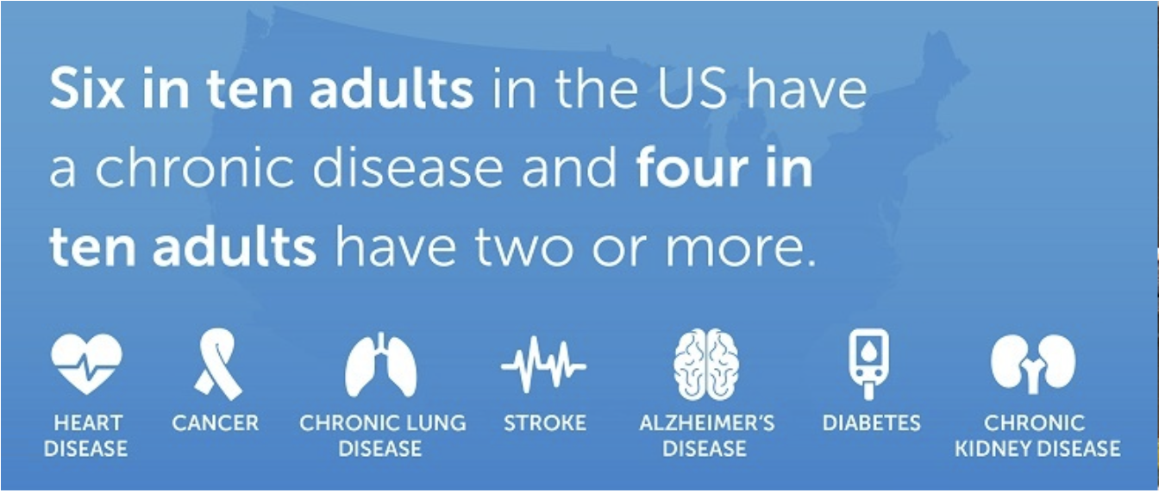
Burden and Cost of Chronic Disease
Three out of four Americans have
at least one chronic disease and over
half of adults have two or more.
90% of $4.9 trillion annual US healthcare costs
Notes:
These chronic diseases account for 90% of the $5 trillion in annual healthcare costs in the US. Most of these costs are incurred in community and hospital clinics, emergency rooms, and hospitals. In other words, in the healthcare system.
https://www.cdc.gov/chronic-disease/data-research/facts-stats/index.html

Slide 6
Hyptertension in America
normal blood pressure
40% don't know they
have hypertension, 1 in 5 Americans
undetected
~50% of Americans
have hypertension
uncontrolled
35% of those with known hypertension
are under control
controlled
Notes:
Rule-of-halves style cascade, built from figures specified by the user: ~50% of Americans have hypertension (rounds NHANES 47.7%, Aug 2021-Aug 2023, NCHS Data Brief 511); 40% of that group unaware (consistent with CDC awareness rate of 59.2% aware / 40.8% unaware); of the 60% who are aware, 35% report control — this 35% figure is a derived approximation (20.7% controlled among all hypertensives / 59.2% aware), not a directly published CDC statistic. Bar segment sizes, top to bottom: No HTN 50%, Unaware 20%, Aware-not-controlled 19.5%, Controlled 10.5% (sums to 100%). The 'no HTN' and 'aware-not-controlled' segments were left unlabeled on the slide since the user only specified the three quoted labels — colored only, per spec.

Slide 7
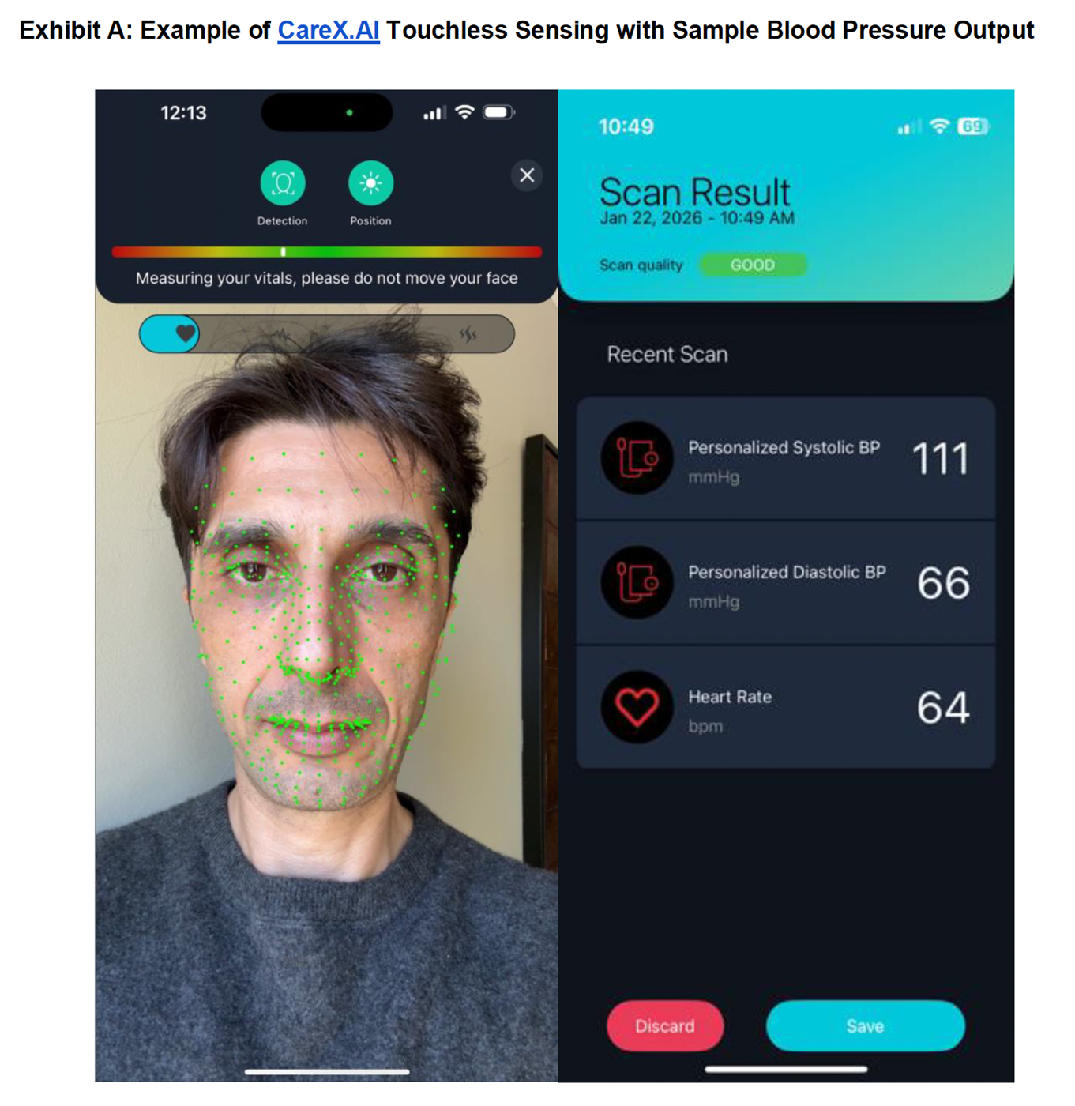
CareX Contactless Blood Pressure Sensor
UCSF Division of General Internal Medicine
IRB-approved technical feasibility study; FDA approval in preparation
Started July 2026
Early feedback: patients like it, trust it more than cuff readings
Challenges
Integrating BP readings into Electronic Health Record
Many companies are selling remote BP monitoring, risking silos and confusion
CEO Ozcan Cikmaz
Notes:
trust in digital > cuff speaks to the fact that carex was more reliable initially than cuff (less variance etc).

Slide 8
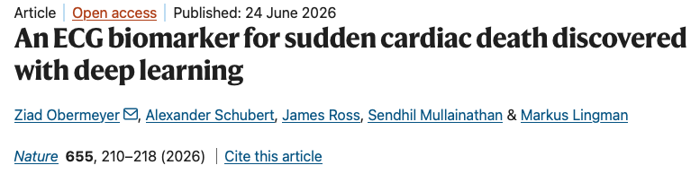


Deep learning AI model
predicts risk of sudden cardiac death

Slide 9
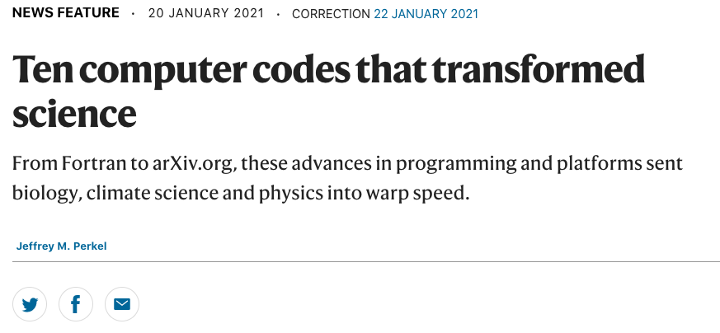
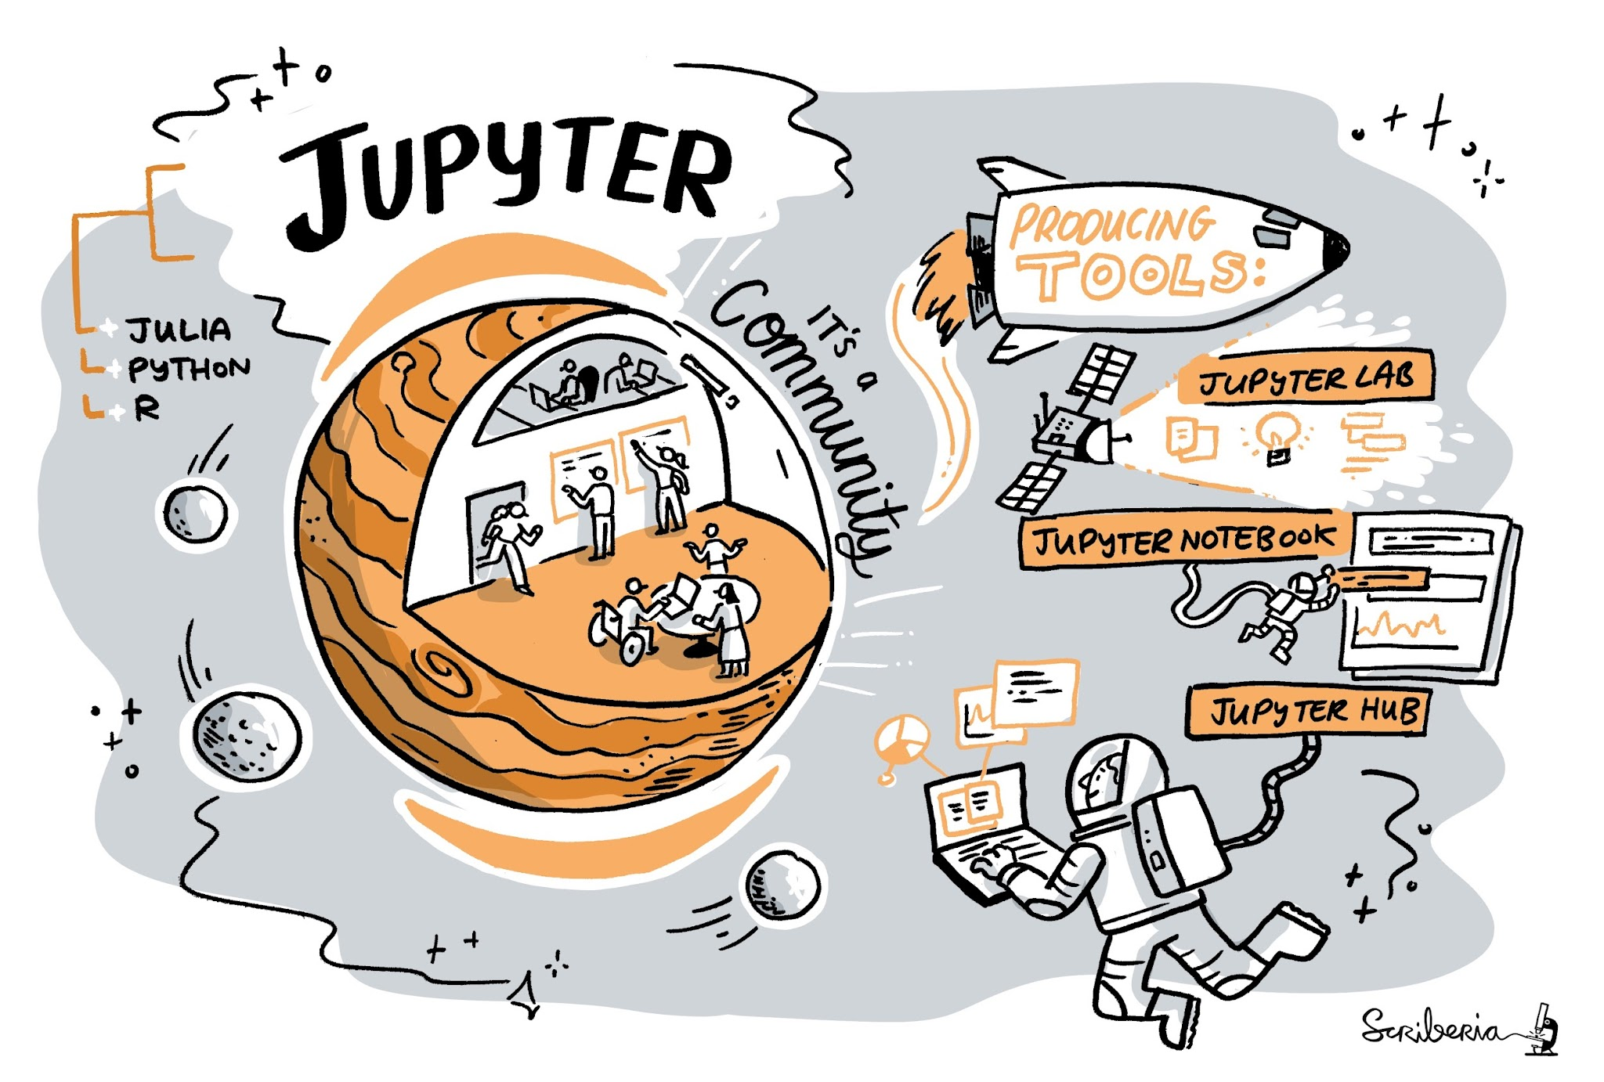


Image credit: Scriberia, for the Turing Way Book Dashes.
Notes:
You may have heard of Jupyter (Jupyter Notebooks? JupyterLab?) ….one of Nature’s 10 computer codes that transformed science…many millions of users and tens of thousands of organizations use Jupyter on a daily basis.
Jupyter is an indispensable scientific platform for entire scientific disciplines: climate and earth sciences, astronomy, and astrophysics.
https://advance.sagepub.com/doi/full/10.22541/au.161298309.98344404/v3?utm_source=chatgpt.com

Slide 10






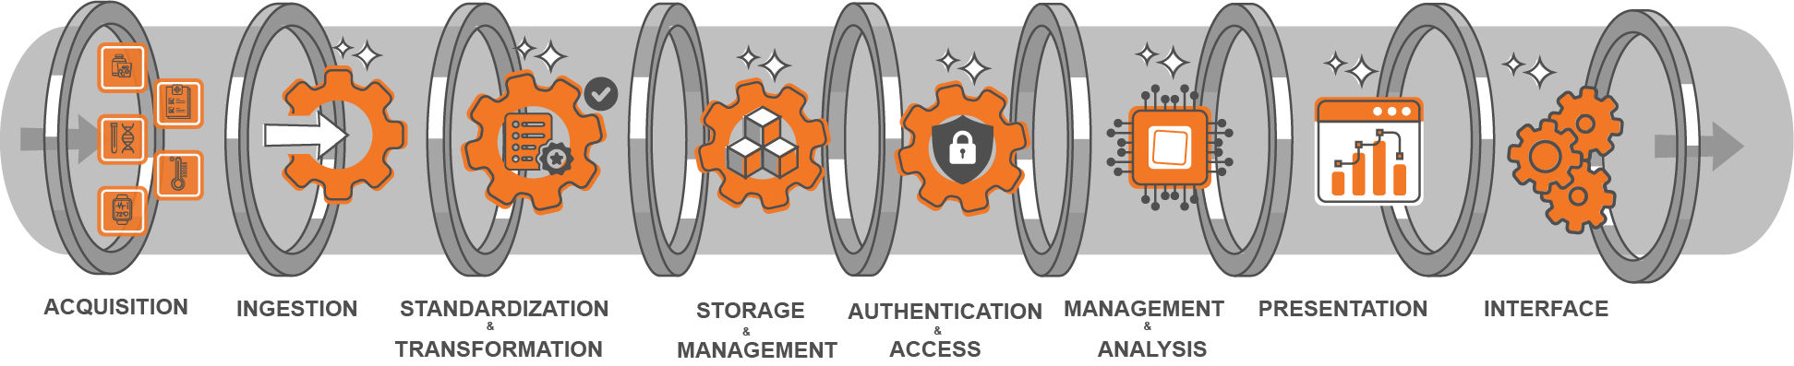
JupyterHealth: Open source
EARLY ADOPTERS
Vertical applications provide targeted solutions for specific use cases…
Clinical Language Bridge
Climate & Sleep
Respiratory Health
Heart Failure
Hypertension
Diabetes
Patient Engagement
JupyterHeatlh combines data interoperability with the analytics power of Project Jupyter to create a scalable, interactive foundation for healthcare transformation.
Notes:
Here’s why JupyterHealth will be a gamechanger. JupyterHealth piggybacks on the proven scale and success of Jupyter to seed a new digital health ecosystem. This new ecosystem has JupyterHealth as the horizontal foundation that provides a scalable backbone serving verticals that provide customized, high-impact solutions such as
For Clinicians and researchers: testing at UCSF Health and Weill Cornell. Can be mix and match because of the common foundation
For Patients: Columbia
For Health Systems: Knit.Health company

Slide 11
Digital health is a frontier made dramatically possible by new sensors and AI
University of California researchers are blazing the path
ida.sim at ucsf.edu
Notes:
Patient-directed, patient-aligned, patient-facing, patient-centered
A Dean’s Andy in our corner

