Slide 1

How Can We Improve Parental Controls to Make them Work for the Entire Family?
Sunny Xun Liu, Ph.D. Director of Research Stanford Social Media Lab

Slide 2
How Can We Improve Parental Controls to Make them Work for the Entire Family?
Awareness
Transparency
Standards
Streamline
Accountability

Slide 3
How Can We Improve Parental Controls to Make them Work for the Entire Family?
Awareness
Transparency
Standards
Understanding
Streamline
Accountability

Slide 4
How Can We Improve Parental Controls to Make them Work for the Entire Family?
Awareness
Transparency
Standards
Understanding
Streamline
Accountability
Action

Slide 5
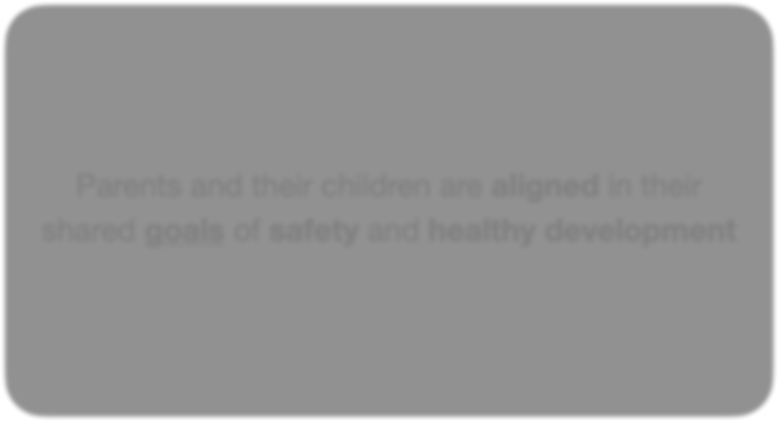

ALIGNMENT
Parents and their children are aligned in their shared goals of safety and healthy development

Slide 6

1. Awareness
Digital Window
Yardi & Bruckman, 2011

Slide 7
1. Awareness
Digital Window
Can we create a digital window that gives parents and caregivers meaningful awareness of their children's online world, without excessive intrusion or total blindness?

Slide 8


2. Transparency
Meaningful Data
Can we have real transparency?
Data on children's online experiences, both at device and platform levels, so parents and caregivers can see what content, encounters, experiences, risks and harms their children face.
Platforms must share this responsibly with parents, researchers, and policymakers.
https://cdh.stanford.edu/sites/g/files/sbiybj29486/files/media/file/youth_safety_and_digital_wellbeing_report_2025.pdf

Slide 9
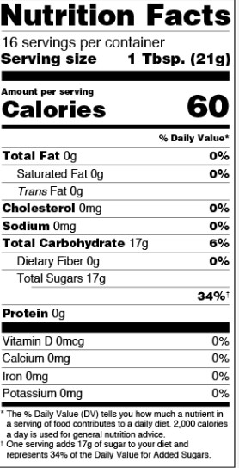
3. Standards

Slide 10

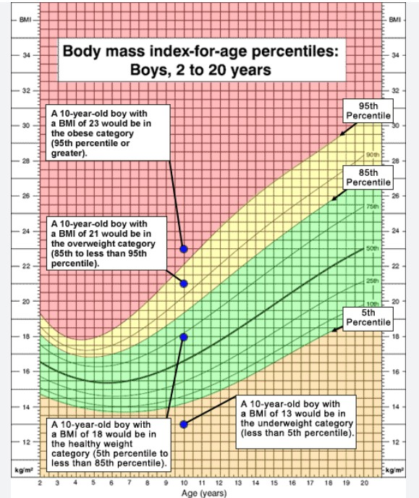
3. Standards

Slide 11

3. Standards
Simple and standardized benchmark
Can we create Digital Nutrition Facts and a Digital BMI to measure children’s online experience?
Can we require platforms to calculate and report this index via dashboards, empowering parents with clear, at-a-glance insights?
Researchers and policymakers would access aggregated data to track trends, refine guidelines, and enforce standards.

Slide 12


4. Streamline

Slide 13
4. Streamline
Easy to use, one-stop interface
What if setting up parental controls was as eﬀortless as online shopping? Imagine a 'one-click' experience: simple, intuitive, and seamless.
Can platforms provide a single dashboard that allows parents to enable age-
appropriate filters, set screen time limits, and monitor activity with a single tap?

Slide 14

5. Accountability
Hold platforms accountable

Slide 15

5. Accountability
Hold platforms accountable
Platforms responsible for creating intuitive, robust, and default-on parental controls.

Slide 16
How Can We Improve Parental Controls to Make them Work for the Entire Family?

Slide 17
How Can We Improve Parental Controls to Make them Work for the Entire Family?
Awareness
Transparency
Standards
Understanding
Streamline
Accountability
Action

