Slide 1


Parental Control Tools on Roblox
Eliza Jacobs, Senior Director, Product Policy

Slide 2

What is Roblox?

Slide 3
Every day on Roblox…
151.5M
Daily Active Users
180
Countries
+66%
13 and Over
6M
Active Experiences
DAU
180
6M
62%
*for the three month period ending September 30, 2025
97.8M
180
6M
62%

Slide 4





Community Standards

Slide 5
Multi-tier Approach to Safety
01
02
03
04
Robust Policies
Automated Moderation
Team of Experts
Safety Partnerships

Slide 6
Communications Safety
✅
✅
✅
Designed to filter inappropriate content
Designed to block sharing of
personal information
Oversight over communication
We are constantly evolving our system and searching for bad actors.

Slide 7

Additional Protections for Youngest Users

Slide 8
What’s New on Roblox
Helping Make the Internet Safer for Kids & Teens
CHALLENGES
Growing independence
Often have their own devices
Seamlessly move between apps
KIDS & TEENS ON ROBLOX
No image or video sharing in chat
Communication oversight
Require age checks to access chat
Open sourcing key safety tech
Engaging with policy makers and child development experts

Slide 9








Roblox’s parental controls are the result of extensive research and consultation with experts
Examples of ESRB ratings

Slide 10
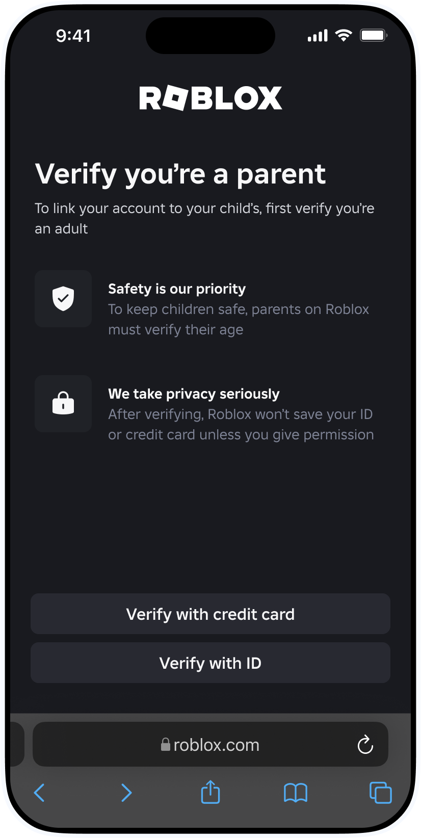
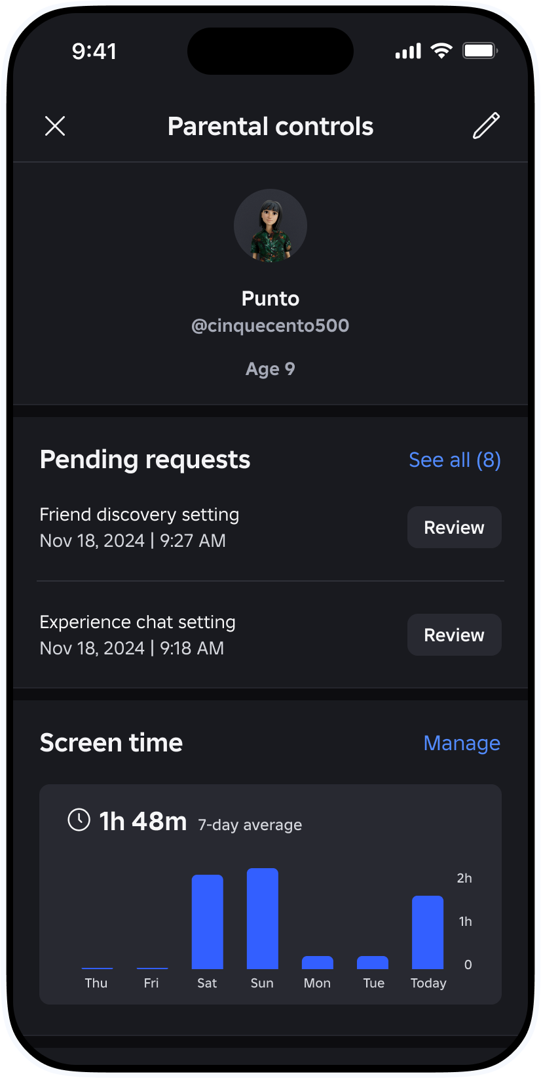

Slide 11
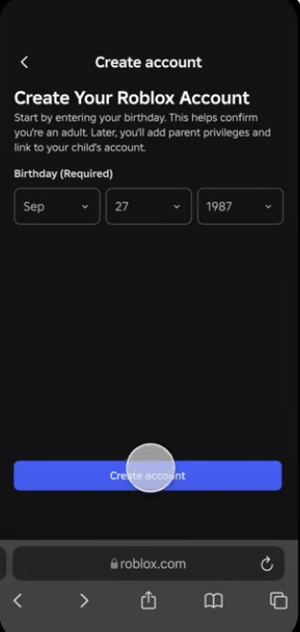
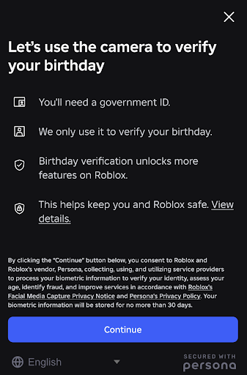
Parent accounts on Roblox must be age verified with government-issued ID or credit card

Slide 12
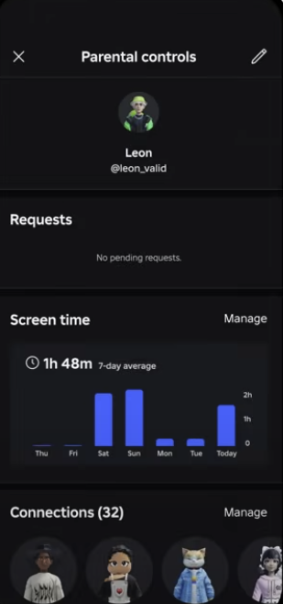
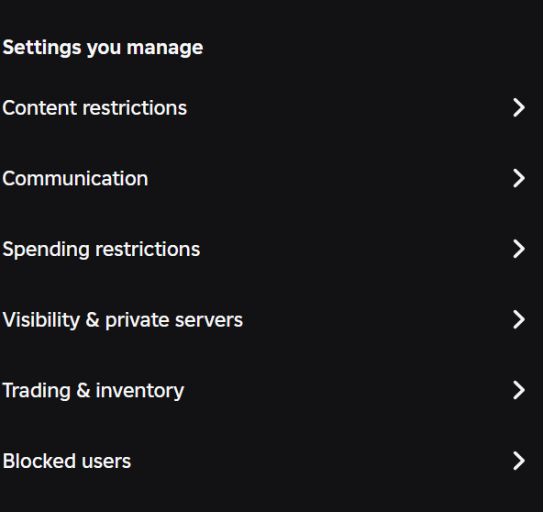
Parents access a user-friendly dashboard with a robust suite of controls

Slide 13
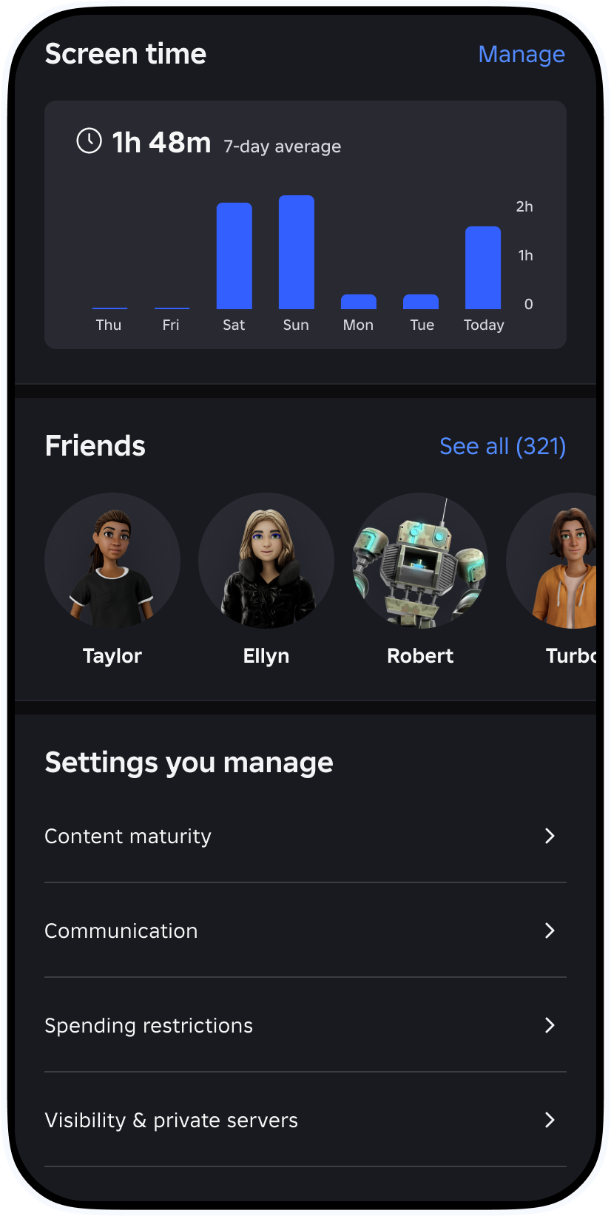
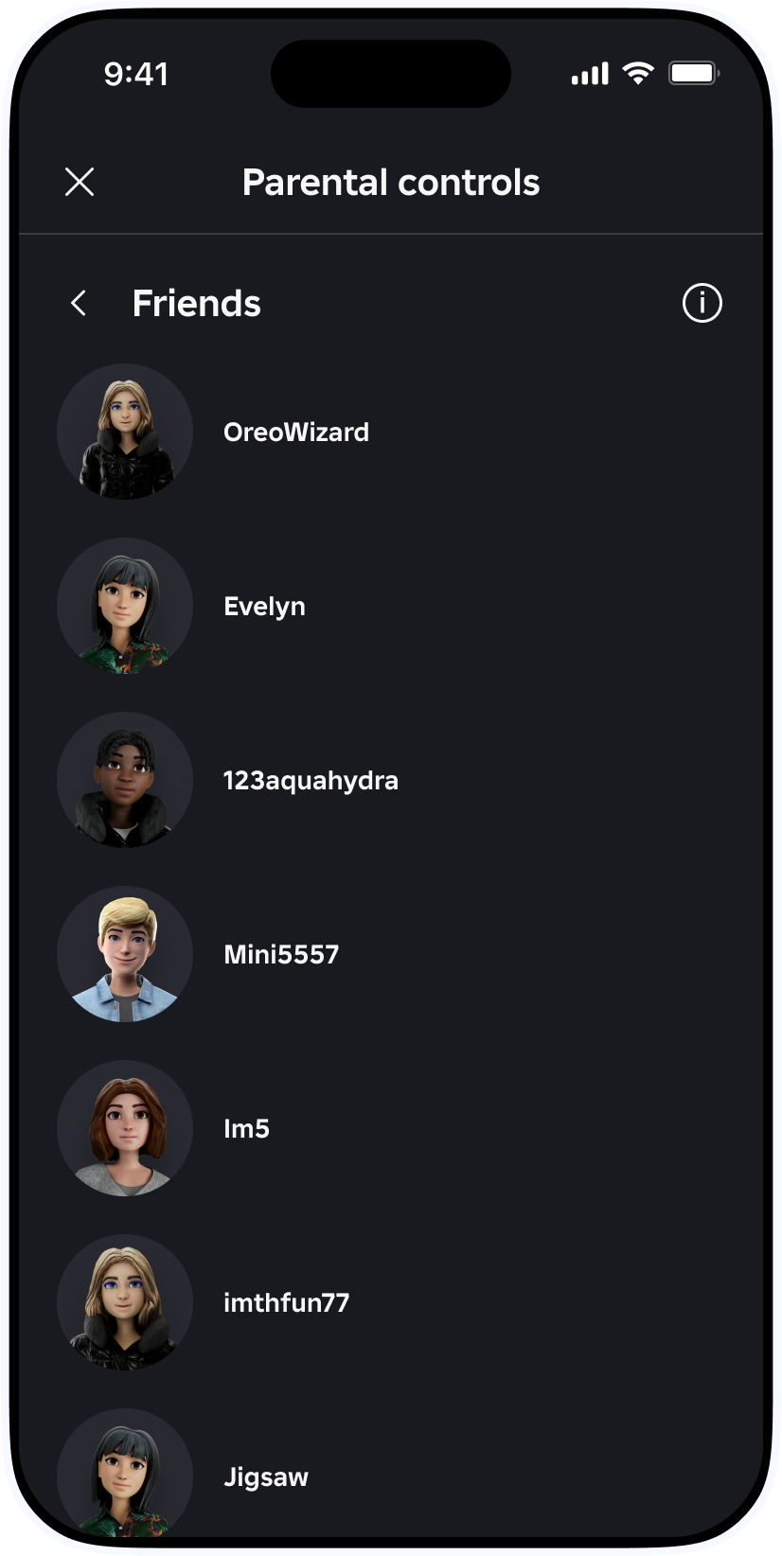
Friends List and Screen Time Monitoring
Parents can see their child’s friends list and set daily screen time limits.
Parents can choose to block specific Connections, which prevents users from being able to directly message their child.
Child accounts cannot unblock a Connection once blocked.
Parents can set daily screen time limits.

Slide 14
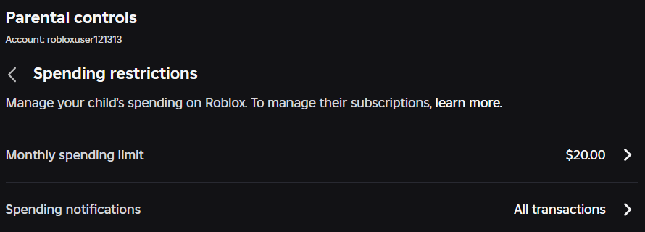
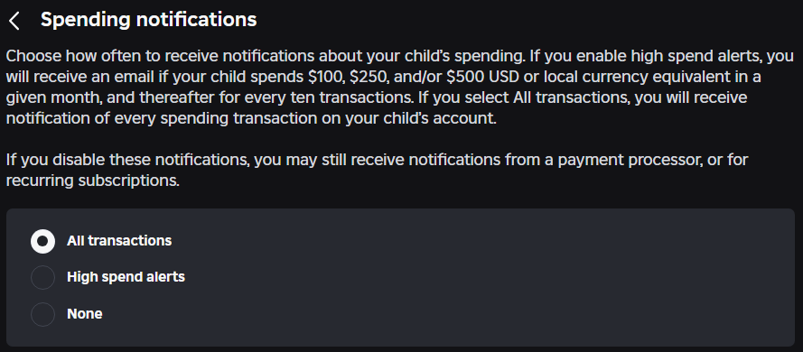
Spending Restrictions Settings

Slide 15
Content Maturity Limits

Slide 16
Content Maturity Settings
Parents can choose a content maturity level for their child’s account.
Built-in maturity settings for users under 9:
Only “Minimal” or “Mild” content accessible
by default.
Only access “Moderate” content with parental consent.
Content Maturity
Content Description
Minimal
May contain occasional mild violence, light unrealistic blood, and/or occasional mild fear
Mild
May contain repeated mild violence, heavy unrealistic blood, mild crude humor, and/or repeated mild fear
May contain moderate violence, light realistic blood, moderate crude humor, unplayable gambling content, and/or moderate fear
Moderate
May contain strong violence, heavy realistic blood, moderate crude humor, romantic themes, unplayable gambling content, the presence of alcohol, strong language, and/or moderate fear
Restricted

Slide 17
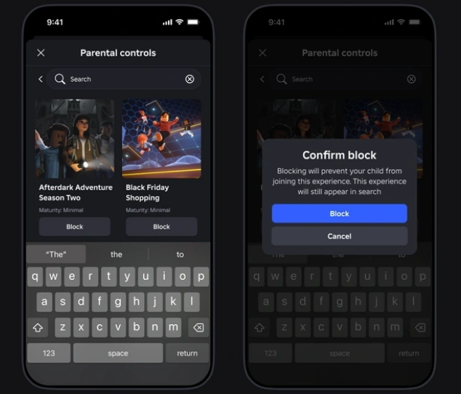
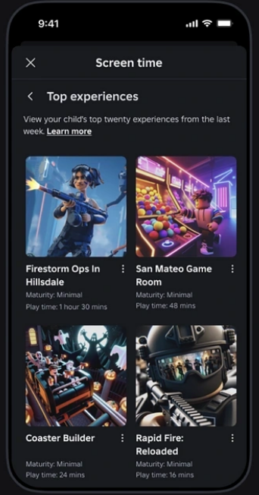
Content Restrictions: Blocked Experiences
Parents can search experiences by name, block experiences, and view their child’s top 20 experiences from the last week
17

Slide 18
Built-in Limits for Communications

Slide 19
✅ We’re moving beyond self declared age
✅ All users will be required to complete an age check to chat
✅ By default: chat is limited to similar age groups
New Safety Standards
We are taking an industry leading approach and establishing the gold standard in age-based chat.

Slide 20
Thank you

