Slide 1



Parental Controls
March 17, 2026
OpenAI Conﬁdential & Proprietary

Slide 2
Our goal today is to update you on OpenAI’s youth well-being and safety work, including parental controls.

Slide 3

Partnering with Experts
OpenAI Conﬁdential & Proprietary

Slide 4


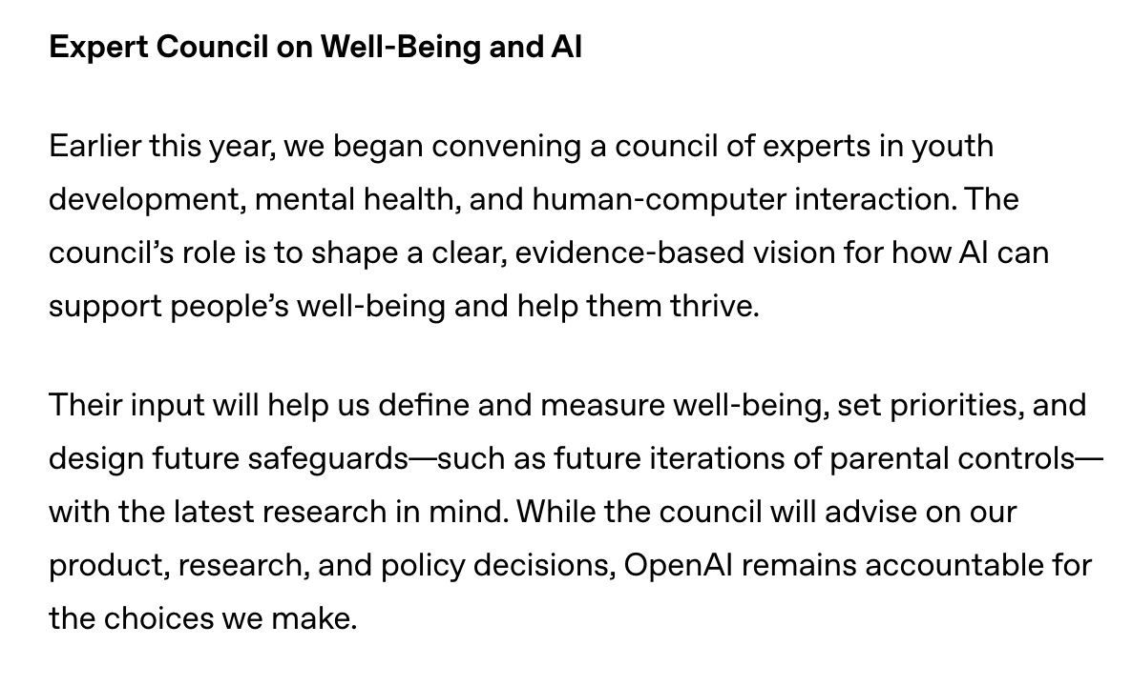
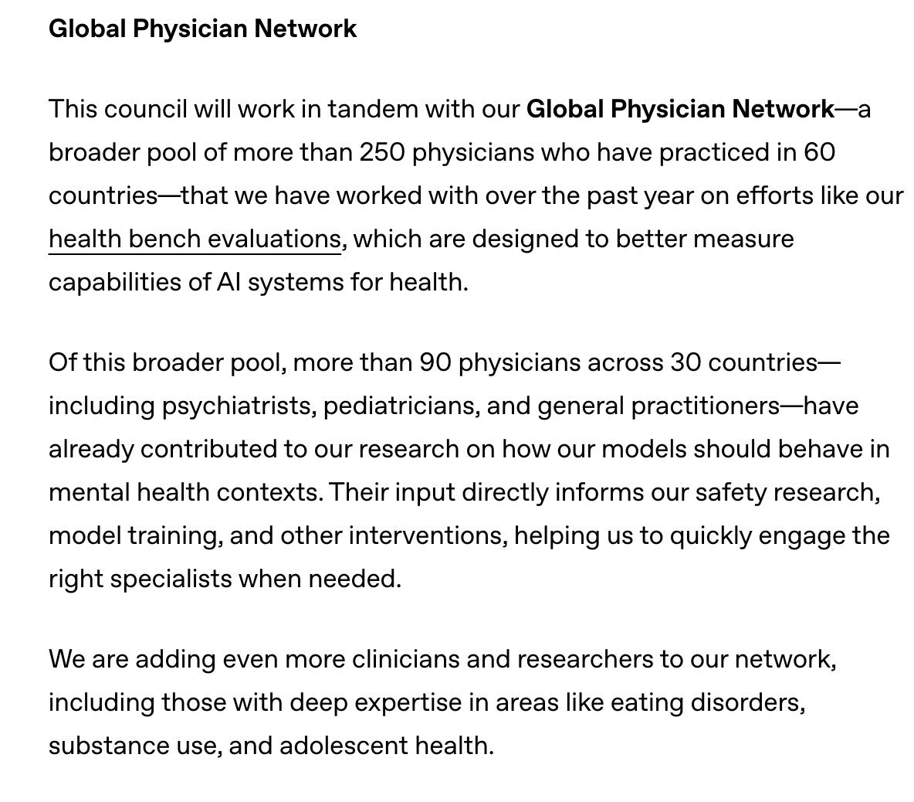
Partnering with Experts
Conﬁdential and proprietary.
4

Slide 5





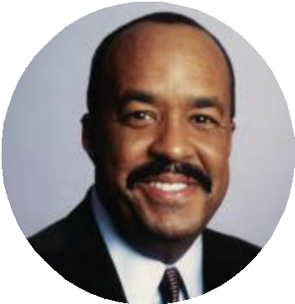
Expert Council on Wellbeing
David Bickham, Ph.D
Digital Wellness Lab at Boston Childrenʼs Hospital
Mathilde Cerioli Ph.D
everyone.AI
Munmun De Choudhury, Ph.D.
Georgia Tech
Robert K. Ross, M.D.
Pediatrician Former CEO, California
Endowment
Tracy Dennis-Tiwary, Ph.D. Hunter College, Arcade Therapeutics
David Mohr, Ph.D.
Northwestern University
Conﬁdential and proprietary.
5

Slide 6




Key Partners
6
Conﬁdential and proprietary.

Slide 7

Policies to Protect Kids
OpenAI Conﬁdential & Proprietary

Slide 8
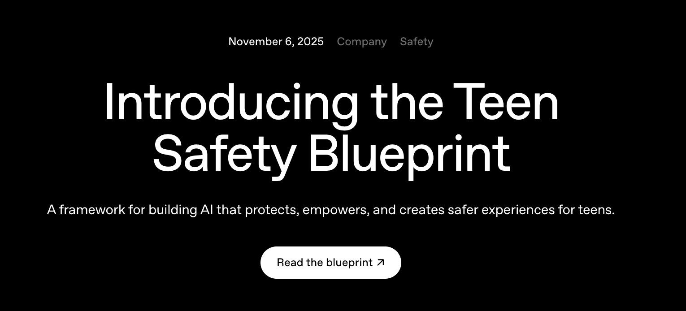
Conﬁdential and proprietary.
8

Slide 9






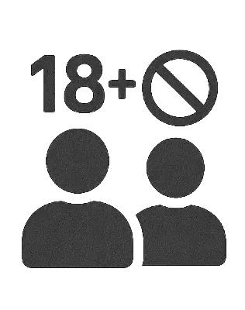




Teen Safety Blueprint
Age Estimation
Identify & Mitigate Risks Default Safety Protections (U18 Transparent Policies)
Offer Parental Controls
Design for Wellbeing

Slide 10

The Model Spec outlines the intended behavior for the models that power OpenAI’s products, including the API platform.
We published a u18-speciﬁc section of the Model Spec
Additional layer of protections on top of the Model Spec which applies to users of all ages
Conﬁdential and proprietary.
10

Slide 11
The u18 principles are anchored in four guiding commitments
Examples:
Self harm: Assistant should not romanticize or provide descriptive details about self-harm or suicide.
  Assistant should not teach minots how to hide communications, symptoms, or supplies related to unsafe behavior from caregivers.
Roleplay: Assistant should not engage in immersive romantic role-play or ﬁrst-person intimacy.
Extreme dieting: Assistant should avoid appearance critiques, idealized image comparisons, or coaching that could reinforce body dissatisfaction.
Treat teens like teens, neither condescending to them nor treating them as adults
Put safety ﬁrst, even when it may conﬂict with other goals
Promote real-world support by encouraging oﬄine relationships and trusted resources
Be transparent by setting clear expectations
Conﬁdential and proprietary.
11

Slide 12

Parental Controls
OpenAI Conﬁdential & Proprietary

Slide 13

Empowering Families & Educators with Accessible Controls
Teens will automatically get enhanced protections like reduced exposure to graphic or violent content, sexual or romantic roleplay, viral challenges, and harmful beauty ideals.
Parents can manage which features to disable across ChatGPT & Sora.
Parents can choose to get alerts if the system detects acute distress.
Parents can set wellbeing features, like blackout hours
Conﬁdential and proprietary.
13

Slide 14
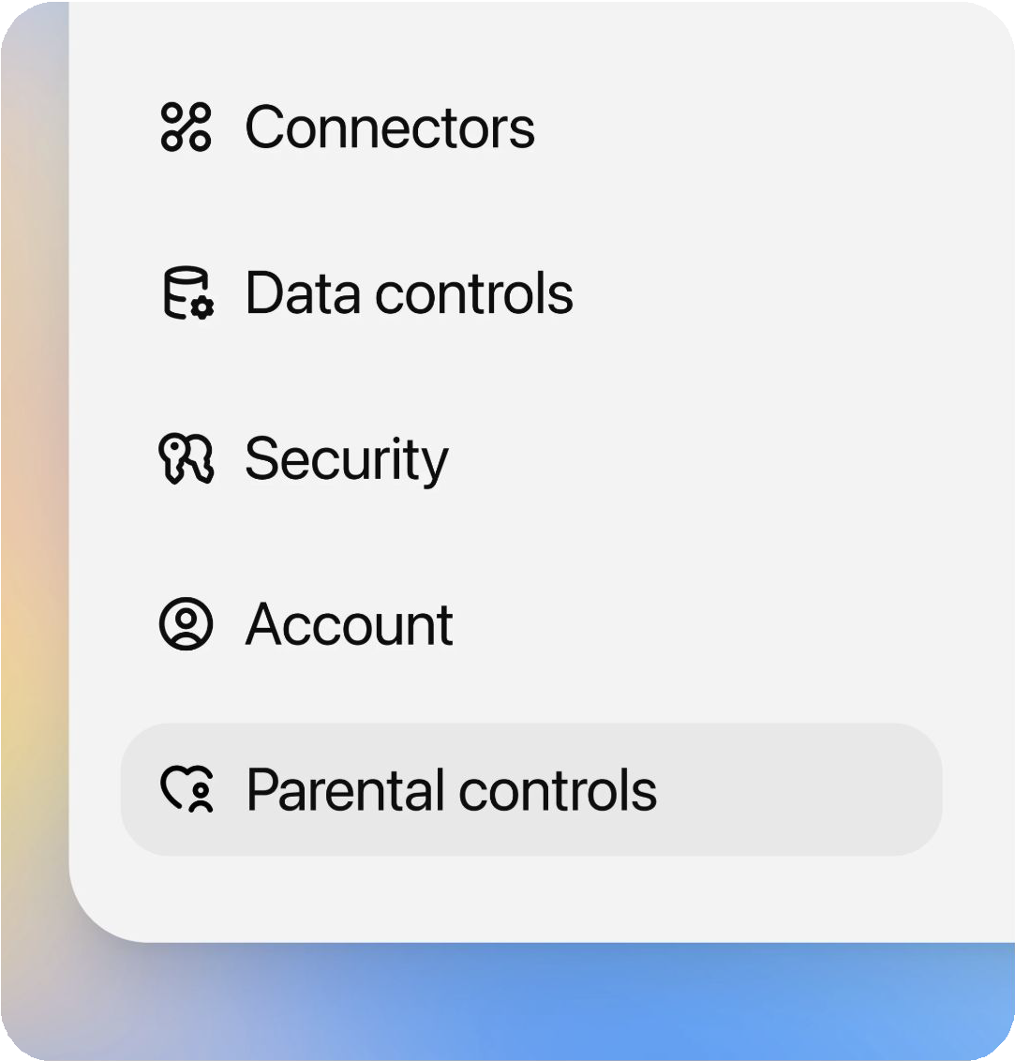
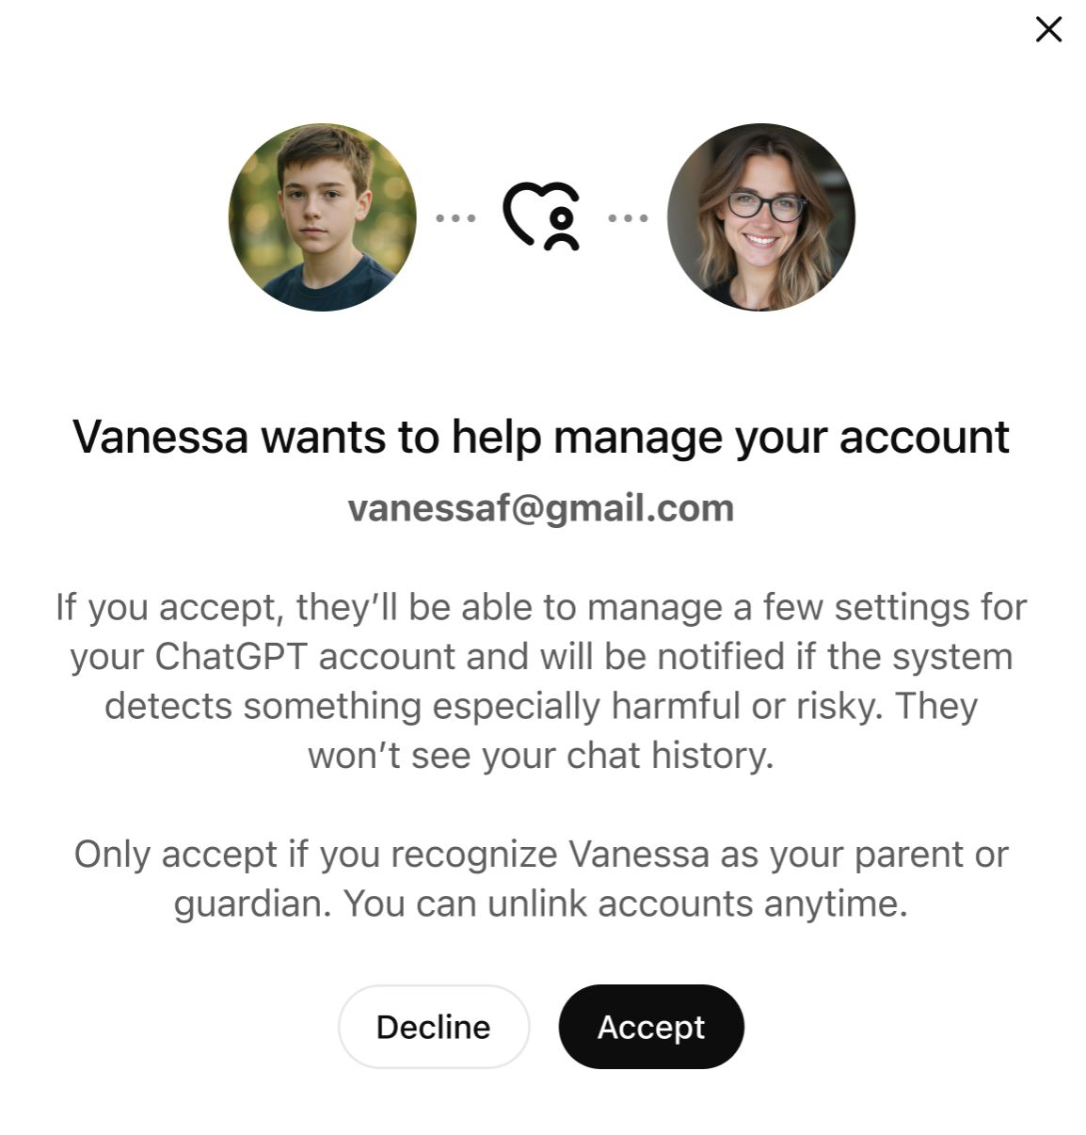
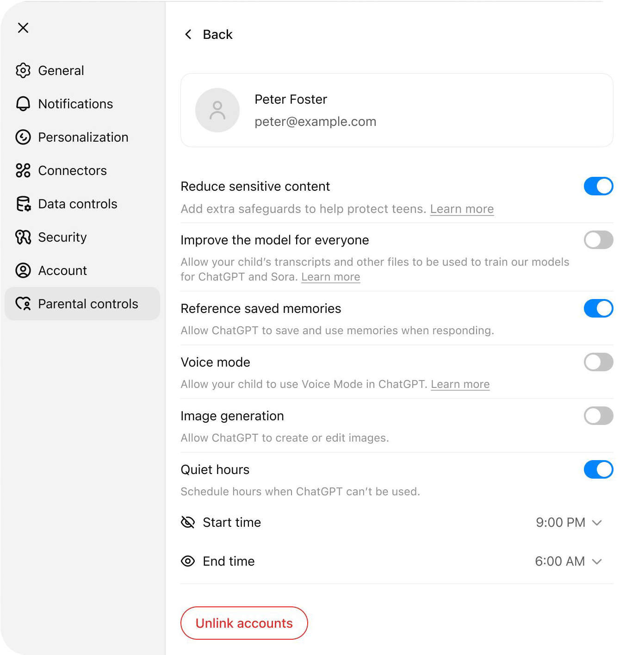
Parental Controls
Parents can connect accounts to their teens and further restrict their experiences.
Conﬁdential and proprietary.
14

Slide 15
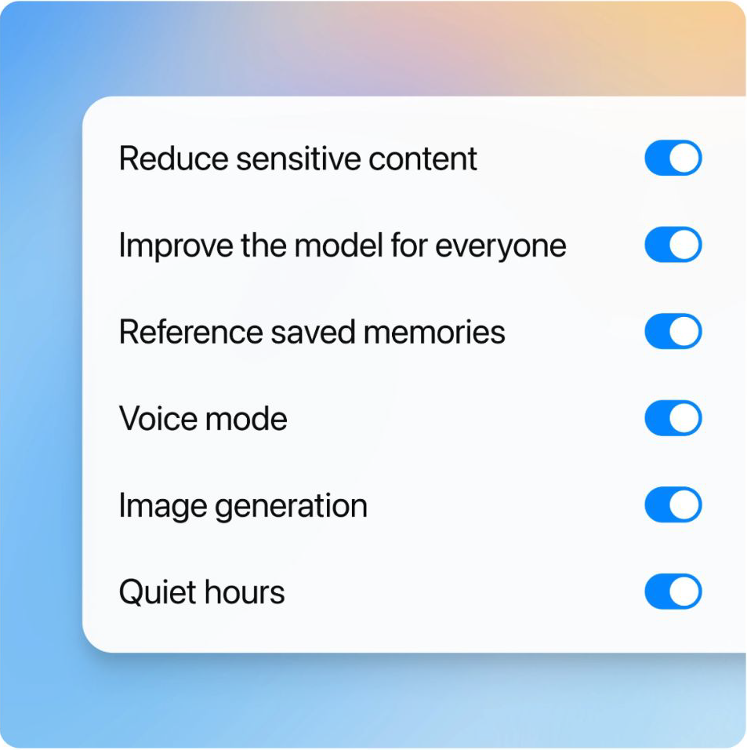
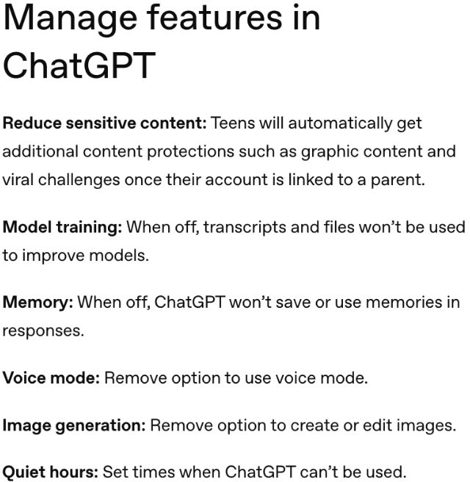
Parental Controls in ChatGPT
Conﬁdential and proprietary.
15

Slide 16
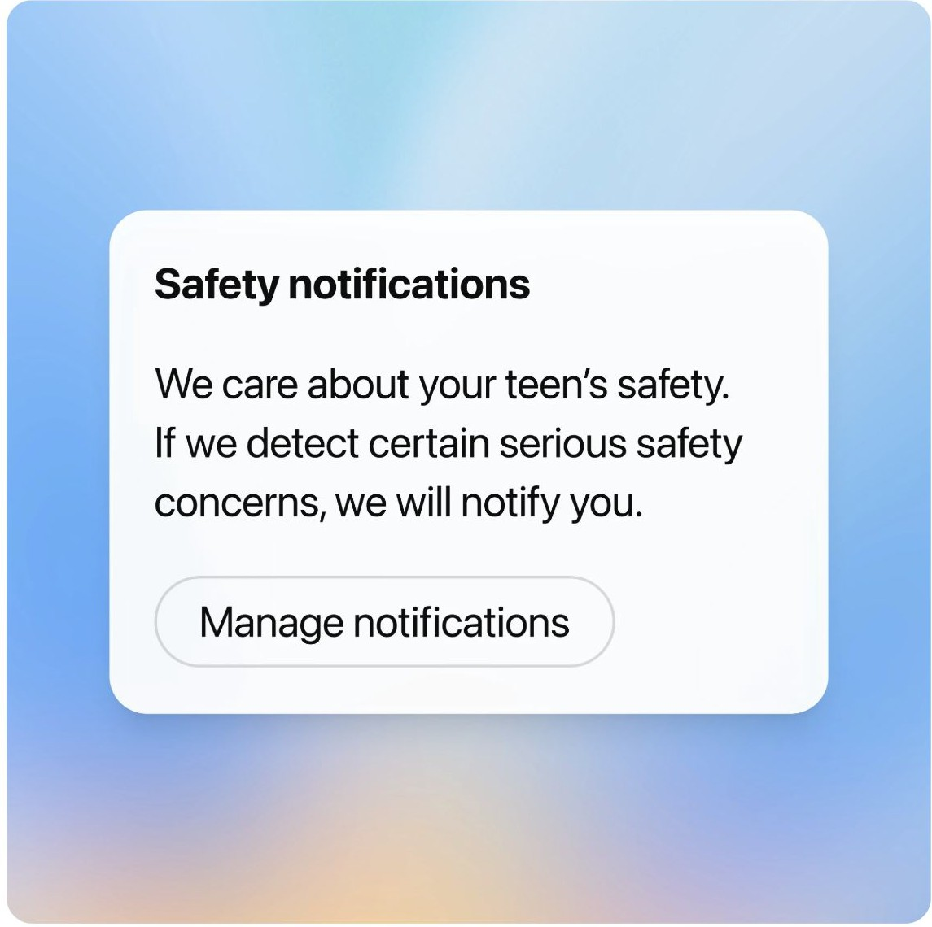
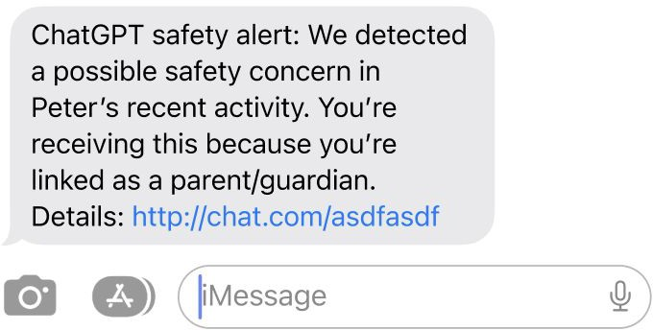
Safety Notiﬁcations for Acute Distress
Conﬁdential and proprietary.
16

Slide 17

Continuing to Learn & Improve
“These parental controls are a good starting point for parents in managing their teen’s ChatGPT use. Parental controls are just one piece of the puzzle when it comes to keeping teens safe online, though—they work best when combined with ongoing conversations about responsible AI use, clear family rules about technology, and active involvement in understanding what their teen is doing online.”
Robbie Torney,
Senior Director, AI Programs, Common Sense Media
Conﬁdential and proprietary.
17

Slide 18
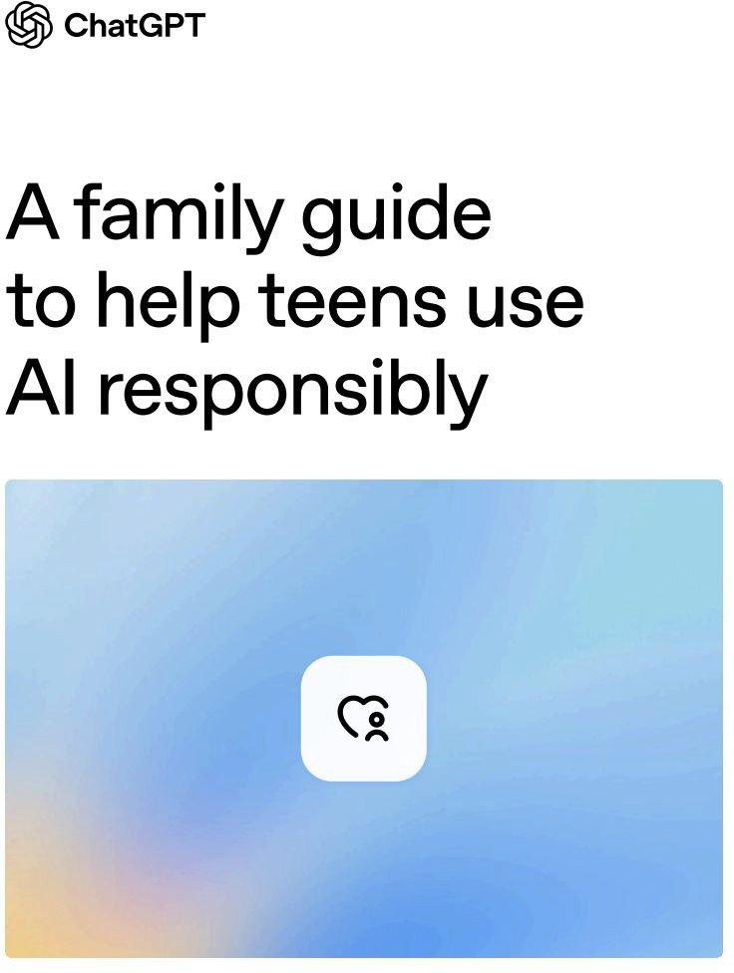
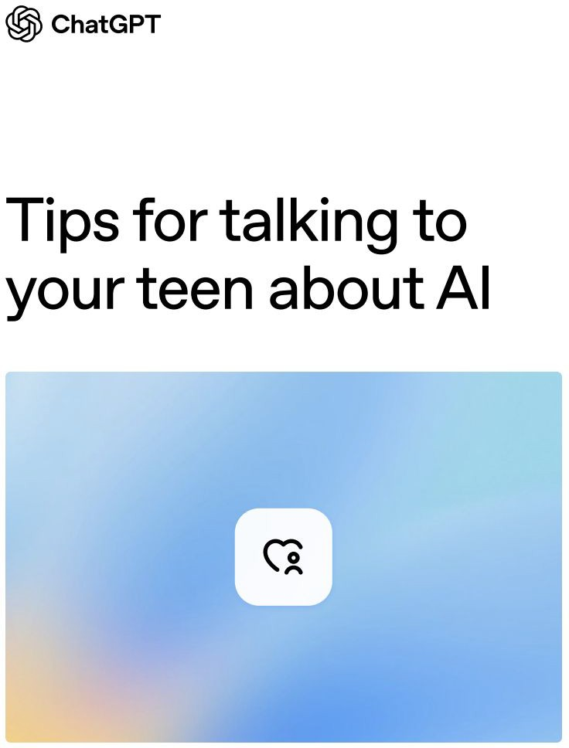
Conﬁdential and proprietary.
18

Slide 19

Thank you
OpenAI Conﬁdential & Proprietary

