Slide 1


Google’s Approach to Kids & Families
Emily Cashman Kirstein
Child Safety Public Policy Lead

Slide 2
At Google our goal is to protect kids from the digital world
in

Slide 3
Growing up with Google
Built to
PROTECT
Designed to
RESPECT
Created to
EMPOWER
Default protections for youth safety and privacy
Tools that respect each family’s unique relationship with technology
Empower kids and teens to more safely explore, grow, and play online

Slide 4
Safety by design
PROTECT
Baseline protections for kids & teens
even before parental tools

Slide 5





Protections across Google services
PROTECT
Search
Image Removal Policy; SafeSearch blur on by default
Location
Timeline disabled; sharing off by default
Play
Blocked downloads for PEGI 18 apps; safety section highlighting which apps follow our Families policies
YouTube
Age-restricted content, built-in wellbeing features, robust parental settings
Gemini
Additional content safeguards, parental or school admin controls
Ads
Personalization disabled; content restrictions in place

Slide 6








For teens & pre-teens, YouTube limits repeated recommendations of videos on topics that
Compare physical features & idealize some types over others
Idealize specific fitness levels or body weights
Feature social aggression
(non-contact fights & intimidation)
Portrays teens to be cruel and malicious or encourages them to ridicule others
Portrays delinquency or negative behaviors
Includes unrealistic or bad financial advice
Google Kids & Families
6

Slide 7


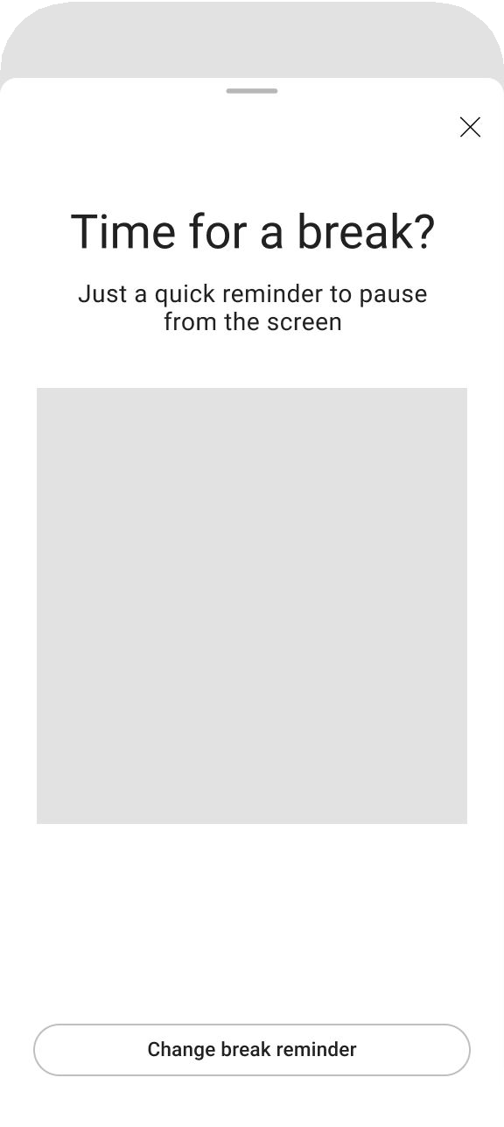

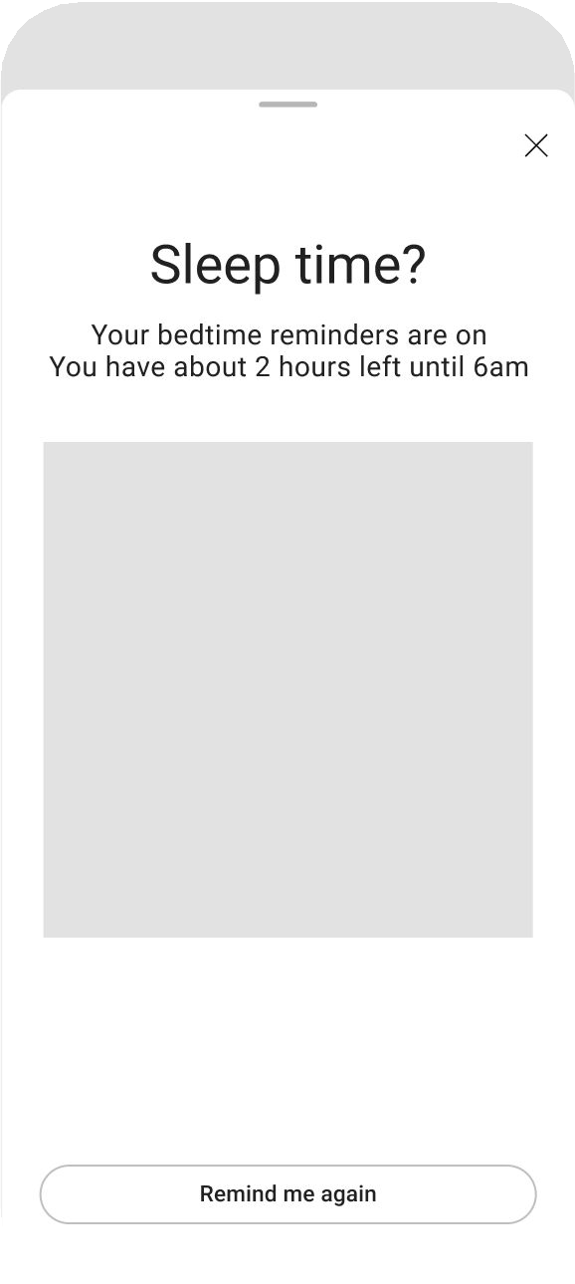




“Take a Break” & “Bedtime” reminders: Full screen takeovers and on by default
Take a break reminder
Pre-reminder warning
Bedtime reminder
7

Slide 8



Steps to understanding a user’s age
PROTECT
Self-declared age
The age users tell us they are when creating a Google account
Age estimation
Use machine learning to estimate if user is an adult/minor based on their activities online
Age veriﬁcation
Ask users to provide a gov ID or other reliable identification to prove they are an adult

Slide 9

Built for choice
RESPECT
Tools for every family to define their
own relationship with technology

Slide 10

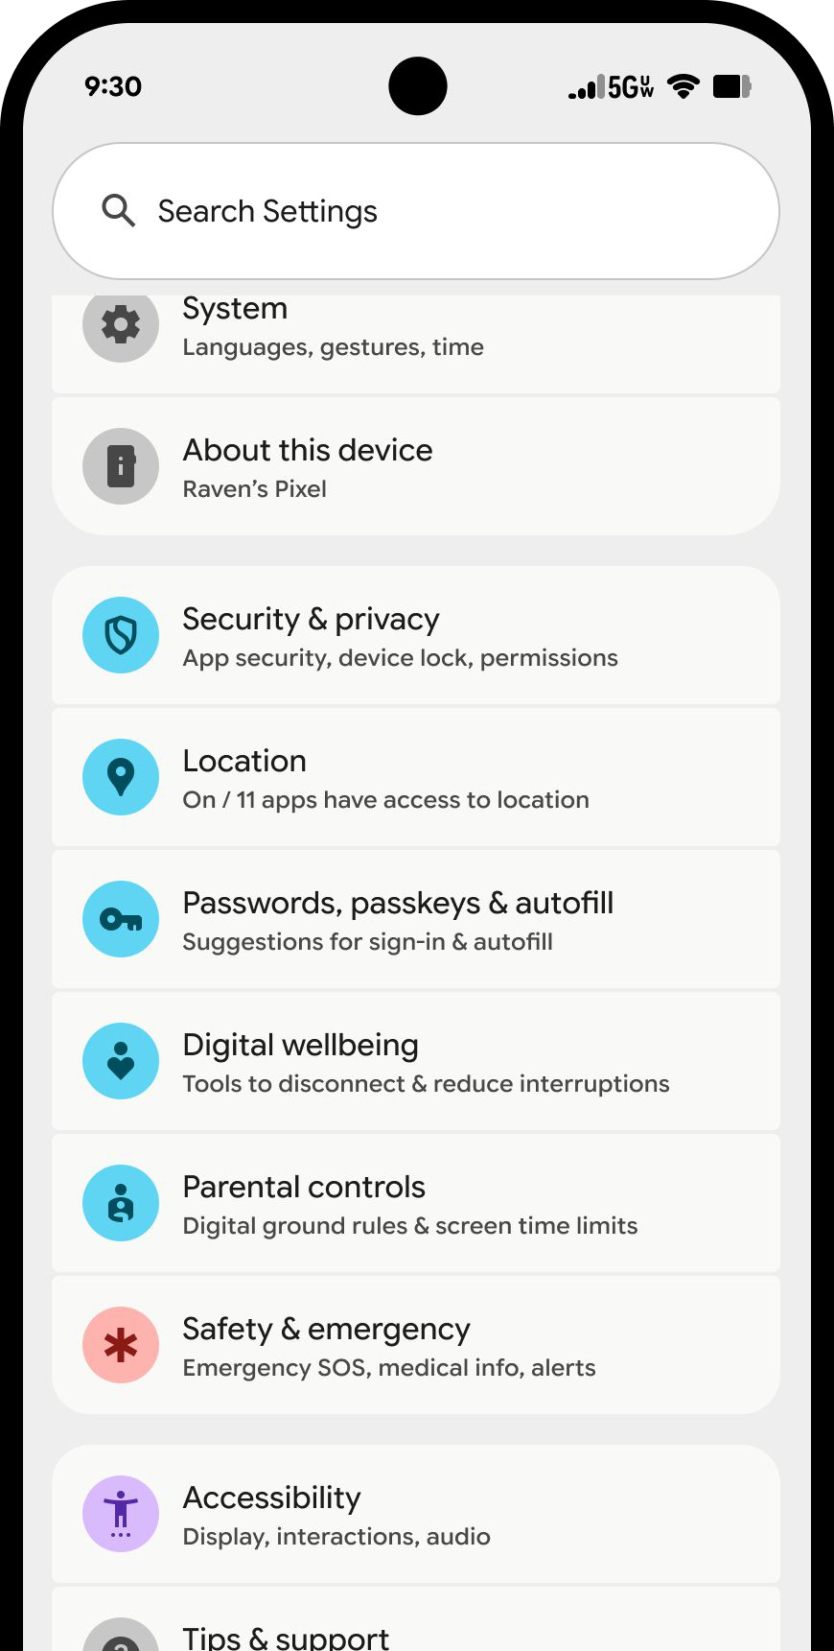
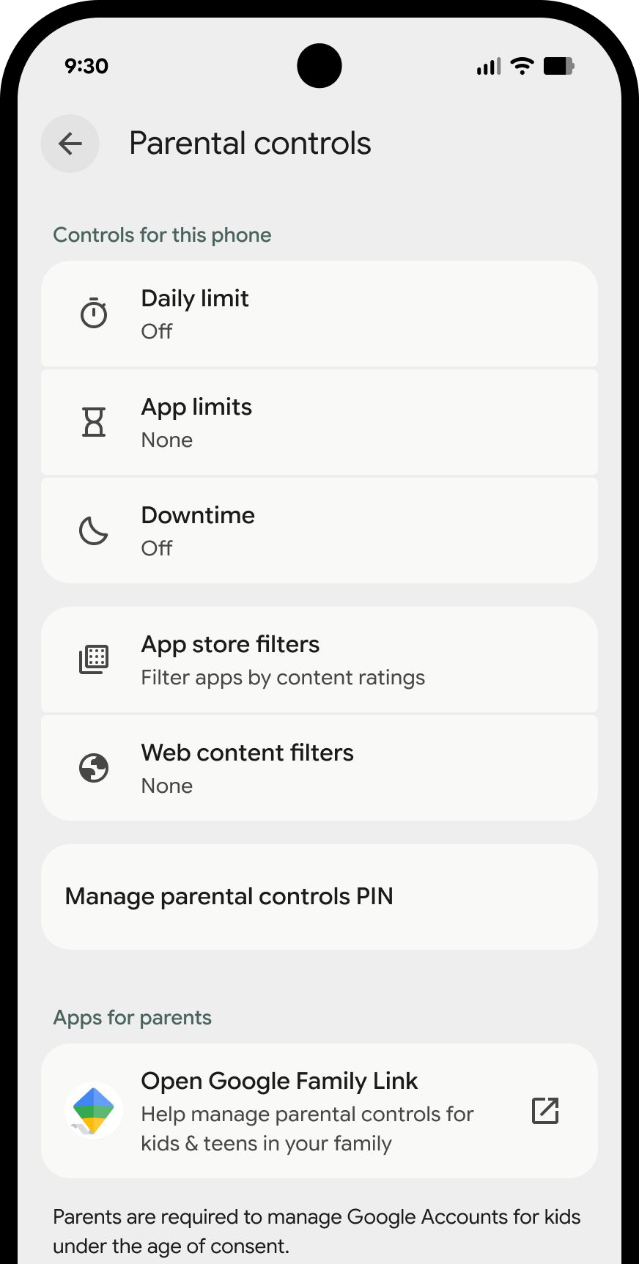
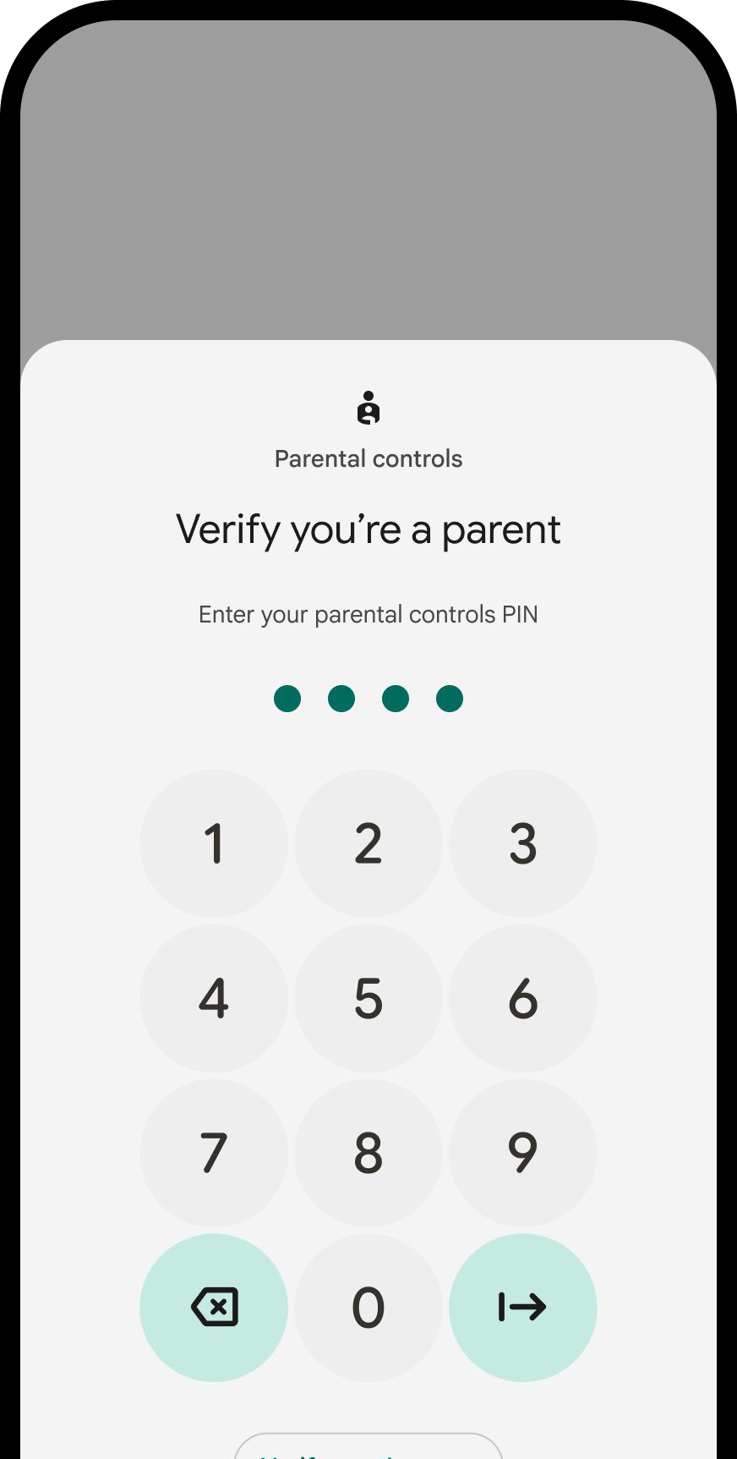


New: Android device parental controls
RESPECT
Google Kids &
Families

Slide 11

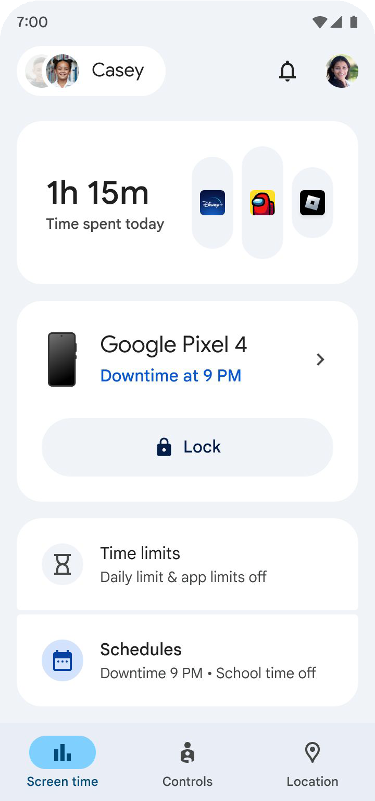
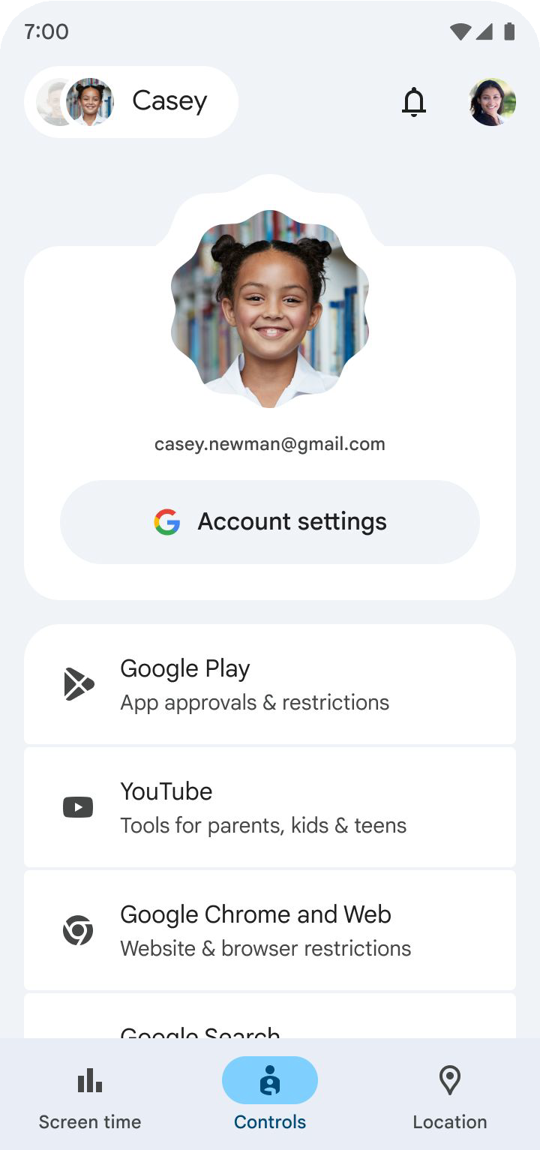
Family Link helps families manage a child’s digital habits
RESPECT
Real-world safety
Practical tools that bolster parents’ efforts in keeping their kids safe offline
Age appropriate
Adapting a kid/teen's experience when online and/or using specific apps
Digital balance
Making sure the right limits are in place so a kid/teen's device usage is balanced
Google
Kids & Families
11

Slide 12
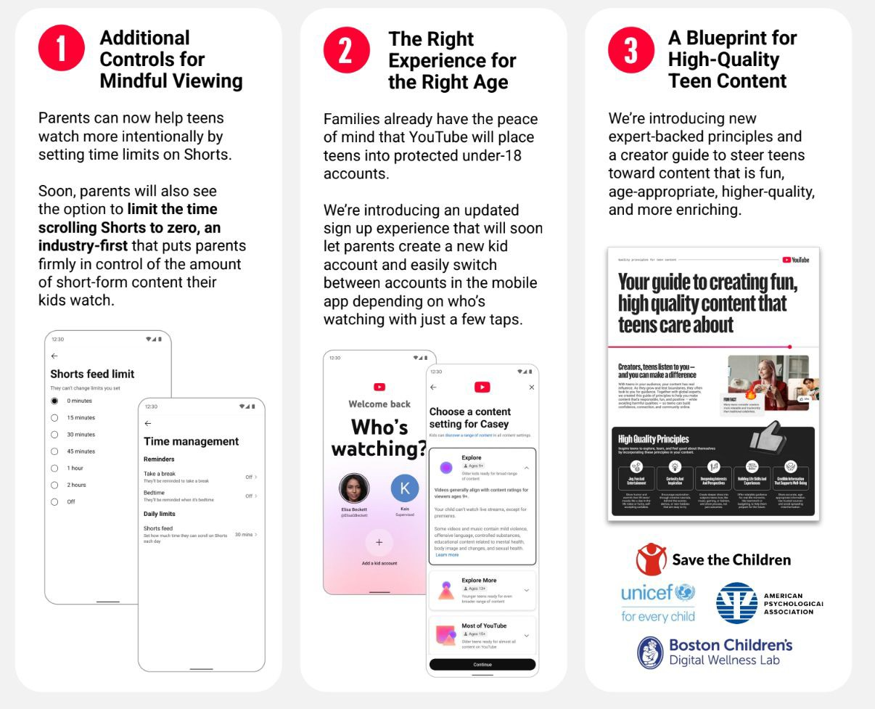

New YouTube Parental Tools
Google Kids & Families
12

Slide 13

Built for Discovery
EMPOWER
Empowering kids and teens to
explore, learn, and play online

Slide 14

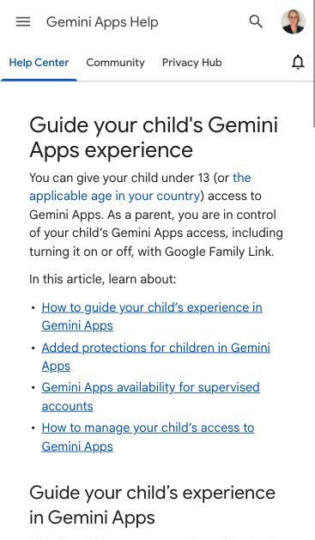

Safeguarded Access
EMPOWER
Designing Gemini for Youth
Parental Tools
Content Safety Guardrails
Persona Protections

Slide 15
Growing up with Google
Built to
PROTECT
Designed to
RESPECT
Created to
EMPOWER

Slide 16

Thank you

