Slide 1

Parental Controls Don’t Work the Way Most Parents Expect
Sunny Xun Liu, Ph.D. Director of Research Stanford Social Media Lab

Slide 2
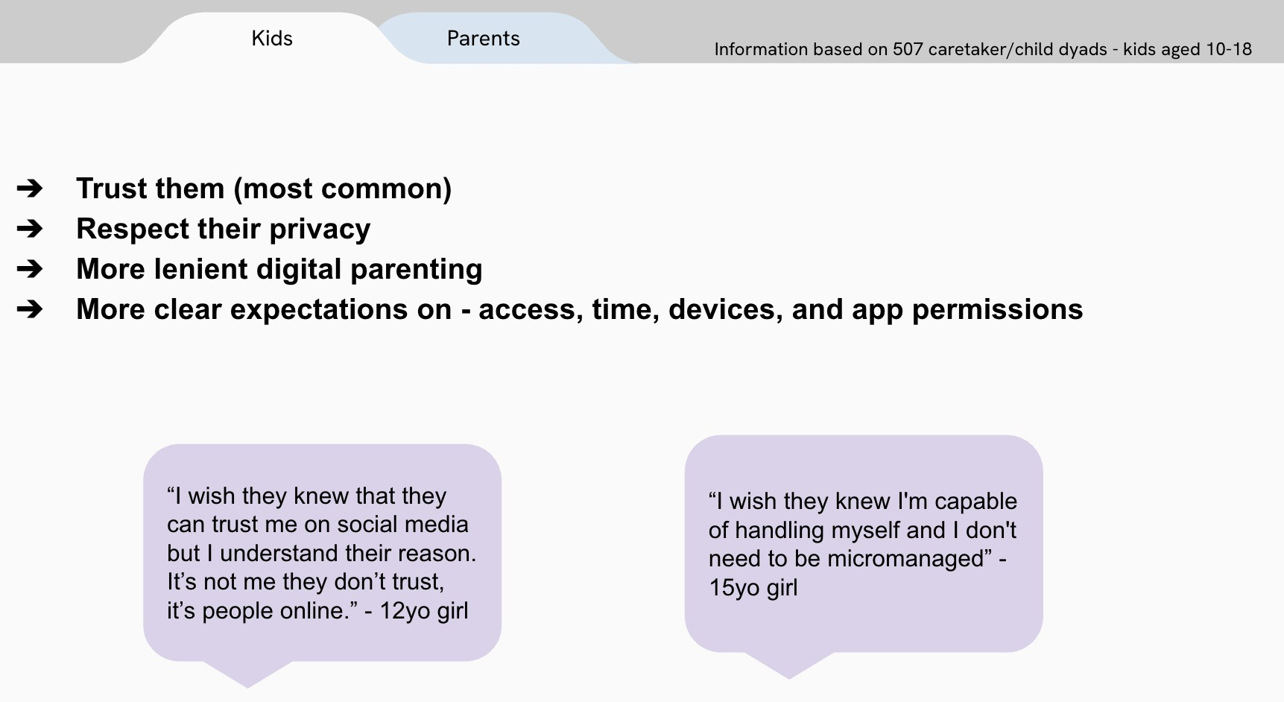

What do children want their parents to understand about their online experiences?

Slide 3
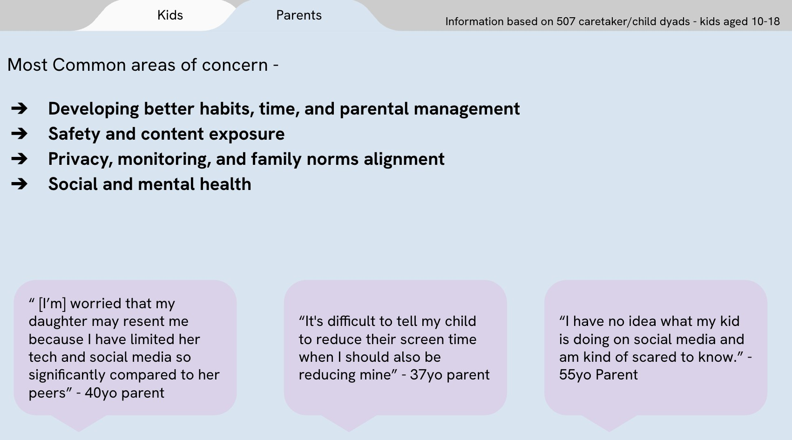
What are parents most concerned about regarding their children’s
online experiences?"

Slide 4


Alignment and Misalignment
ALIGNMENT
MISALIGNMENT
Parents and their children are misaligned in how to approach achieving those goals.
Parents and their children are aligned in their shared goals of safety and healthy development
They disagree over how to control screentime use and how to define boundaries.

Slide 5
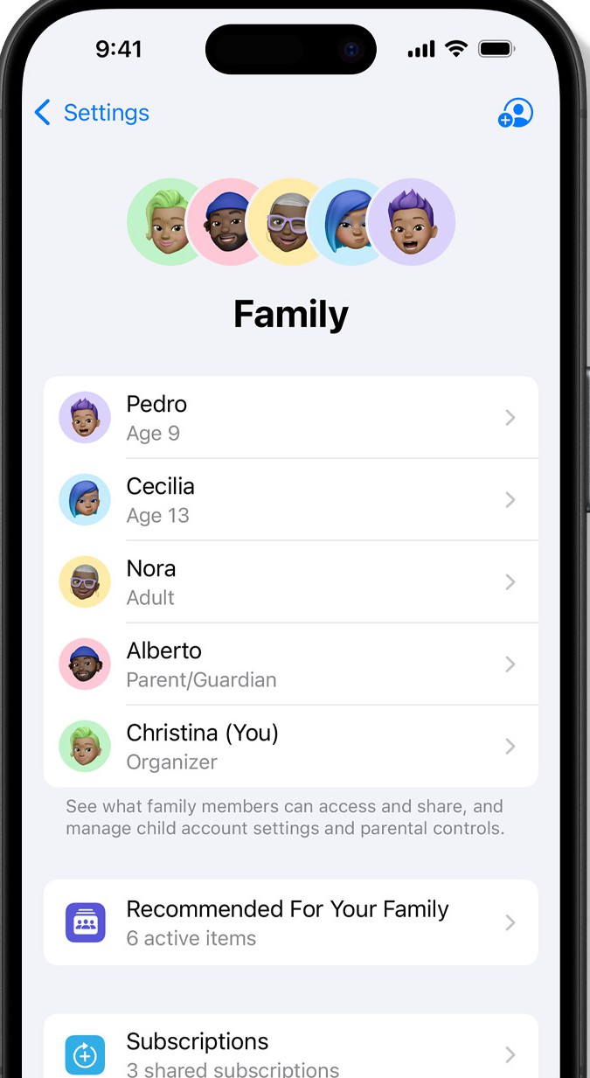
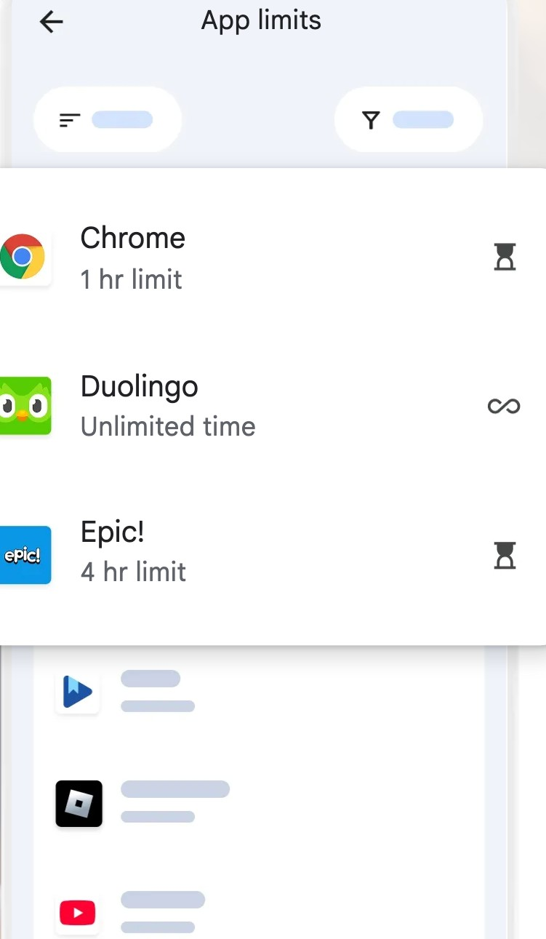



What are Parental Controls?
Definition:
Tools and features to manage children's digital access (e.g., screen time limits, content filters, app restrictions).
Some Examples:
iOS Family Sharing, Android Family Link, third-party apps like Bark, Qustodio or Net Nanny.

Slide 6
Why Current Parental Controls Don’t Work?
1. Digital parenting is challenging

Slide 7
Why Current Parental Controls Don’t Work?
Digital parenting is challenging
Tech is complicated

Slide 8
Why Current Parental Controls Don’t Work?
Digital parenting is challenging
Tech is complicated
Constraints of parental controls

Slide 9
Why Current Parental Controls Don’t Work?
Digital parenting is challenging
Tech is complicated
Constraints of parental controls
Accessibility and equity gap
Livingstone, & Byrne, 2018; Livingstone, & Blum-Ross, 2020; Modecki et al, 2022; Page Jeﬀery, 2021; Richter, et al, 2025; Stoilova, et al., 2024

Slide 10

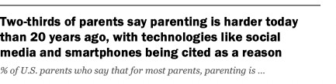
1. Digital Parenting is Challenging
Source: https://www.pewresearch.org/internet/2020/07/28/parenting-children-in-the-age-of-screens/

Slide 11
1. Digital Parenting is Challenging
“[There is a] pressure to be… everything, everywhere, all at once to your child… The sense of constantly needing to do more, and be around more, and be more of this, and more of that within the environment that doesn't really support.”
Parenting

Slide 12

1. Digital Parenting is Challenging
“[There is a] pressure to be… everything, everywhere, all at once to your child… The sense of constantly needing to do more, and be around more, and be more of this, and more of that within the environment that doesn't really support.”
Parenting
“[It is a struggle to] make sure my child doesn't see inappropriate images or pornography, knows who he interacts with, and that he's not bullied.”
Online Safety

Slide 13
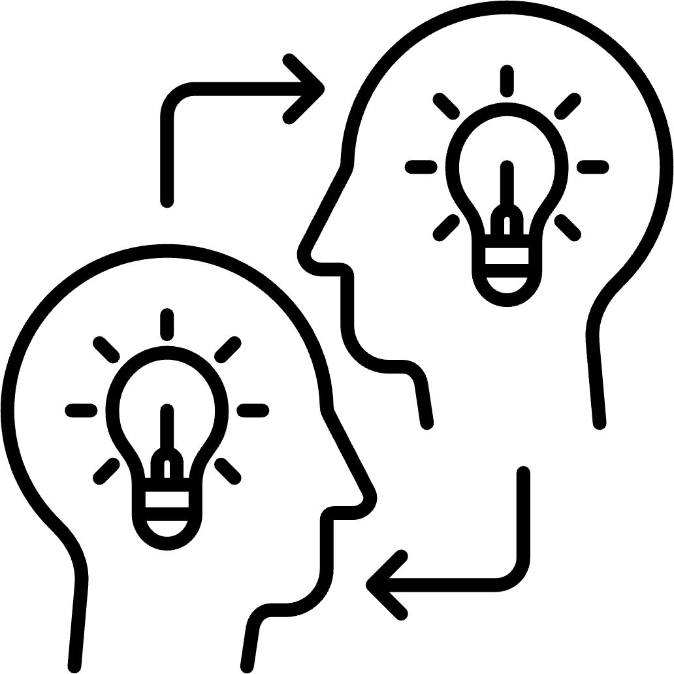
1. Digital Parenting is Challenging
“[There is a] pressure to be… everything, everywhere, all at once to your child… The sense of constantly needing to do more, and be around more, and be more of this, and more of that within the environment that doesn't really support.”
Parenting
“[It is a struggle to] make sure my child doesn't see inappropriate images or pornography, knows who he interacts with, and that he's not bullied.”
Online Safety
“[My daughter] knows more about it than I do.”
Knowledge Gap

Slide 14




2. Tech is Complicated
Diﬀerent platforms, interfaces and products

Slide 15

2. Tech is Complicated
Diﬀerent platforms, interfaces and products
Features and settings are constantly updated

Slide 16


2. Tech is Complicated
Diﬀerent platforms, interfaces and products
Features and settings are constantly updated
Device level vs app level

Slide 17
3: Constraints of parental controls

Slide 18

3: Constraints of parental controls
Circumventions can increase risk

Slide 19

3: Constraints of parental controls
Circumventions can increase risk
Protections can backfire

Slide 20

4: Accessibility and Equity Gap
Family contextual factors aﬀect eﬀectiveness

Slide 21
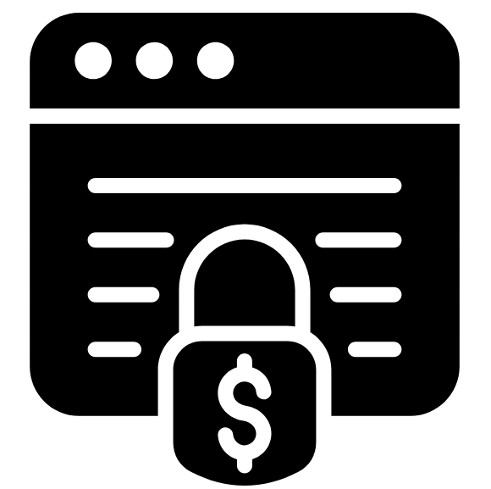
4: Accessibility and Equity Gap
Family contextual factors aﬀect eﬀectiveness
Paywalls and resource availability aﬀect accessibility of tools

Slide 22
Why Current Parental Controls Don’t Work?
Digital parenting is challenging
Tech is complicated
Constraints of parental controls
Accessibility and equity gap
Livingstone, & Byrne, 2018; Livingstone, & Blum-Ross, 2020; Modecki et al, 2022; Page Jeﬀery, 2021; Richter, et al, 2025; Stoilova, et al., 2024

